Slide 1
CDR Infantry Supply Station
Yuyong Yao, YiFeng Wang, Xinru Song, & Rahmat Saeedi
(Group 9)

Slide 2
Why this project matters
Design Requirements
Design Challenges
& Objective
Proposed Design
Schedule & Milestones
Components
Budget
Suppliers
Questions & Feedbacks

Slide 3
Why this project matters
DJI RoboMasters Competition 2018
Annual Robotic Competition for Engineering Students hosted in China

Slide 4
Why this project matters
DJI RoboMasters Competition 2018
Annual Robotic Competition for Engineering Students hosted in China
To Win Against CalTech RoboMasters Student Group

Slide 5
Design Requirements
End User: 2 Infantry Robots, Docked Bellow
Max Size: 1m*1m*1m Specs of Bullets:
2.6 g (±5%),
Plastic,
17 mm (-3% to 0%) in diameter
Should be able to store ~400 bullets

Slide 6
Objective
Be fully automatic
Minimize the filling time
Follow restrictions of the competition
Prevent any jamming of bullets in the station

Slide 7



Slide 8
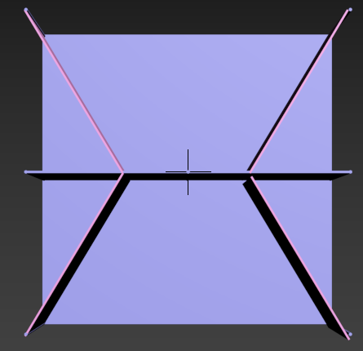
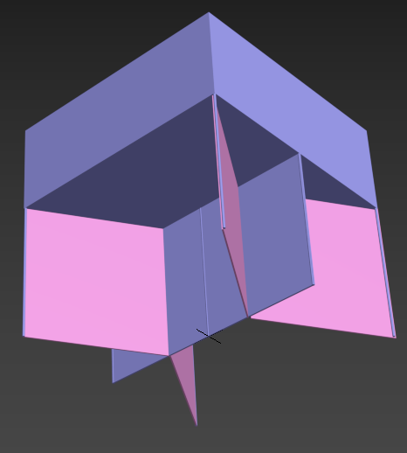
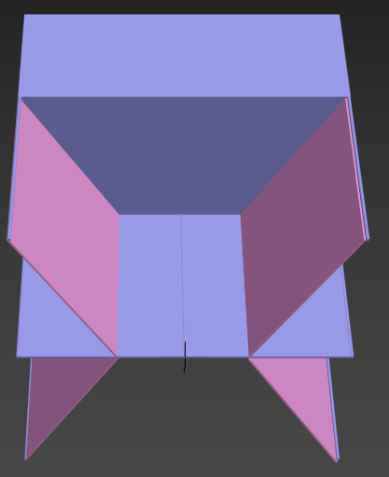

Slide 9
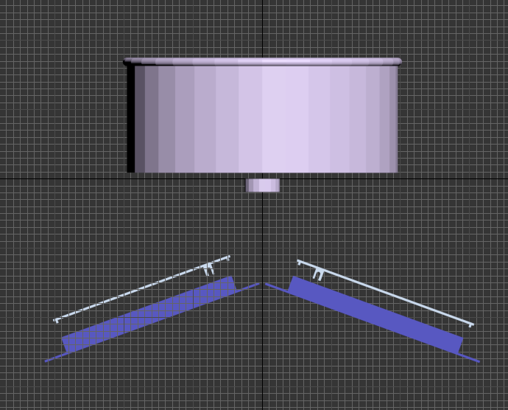
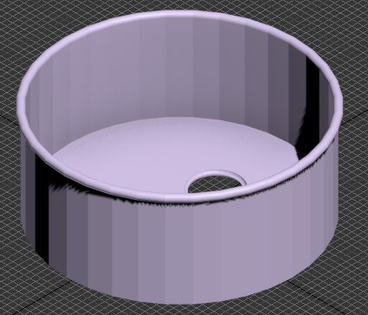

Slide 10
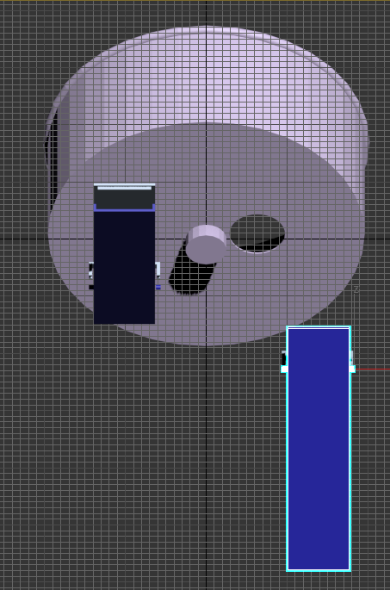
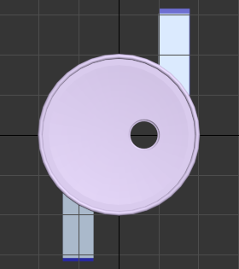

Slide 11
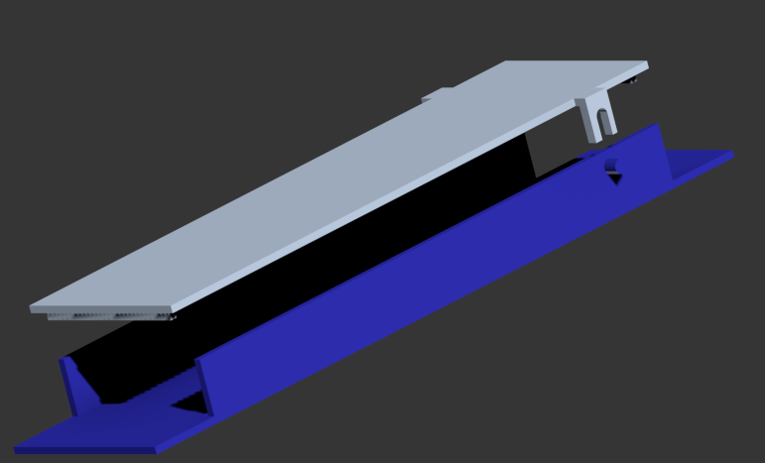
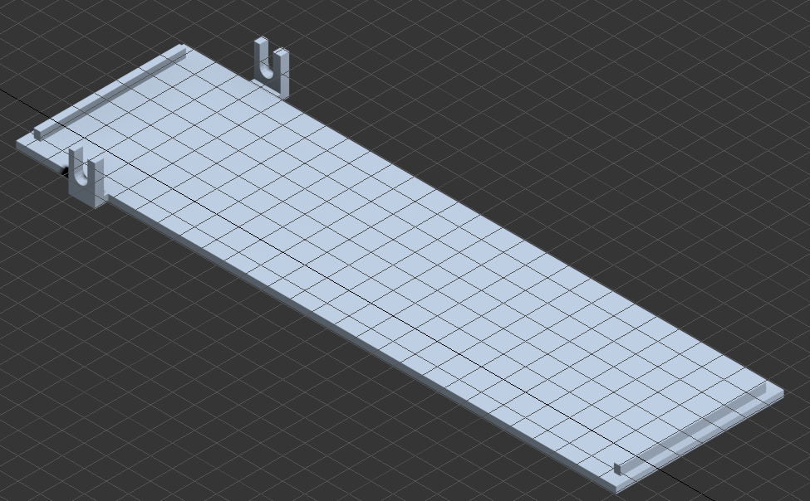

Slide 12

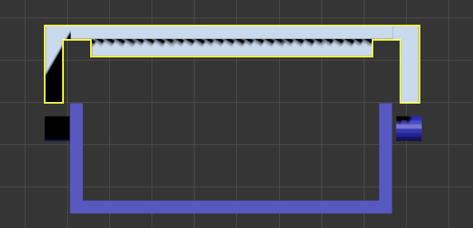

Slide 13
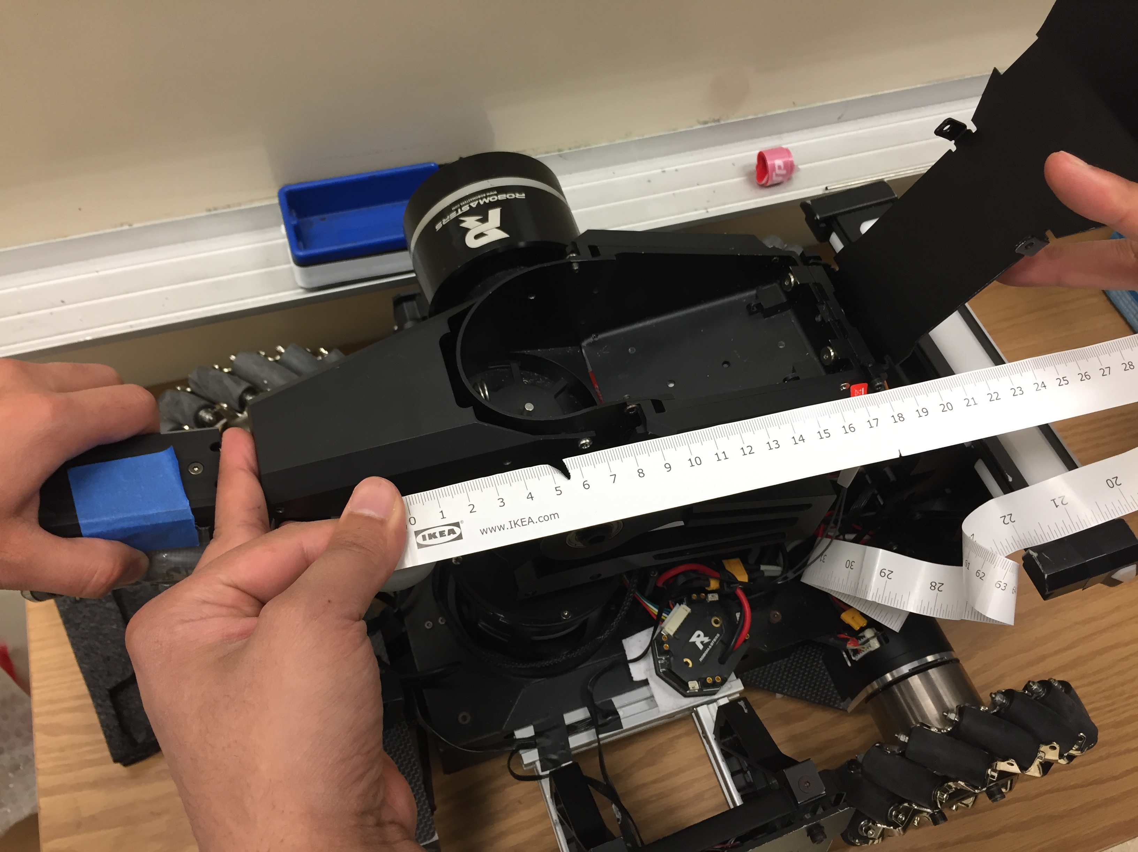
End User: Infantry Robot

Slide 14
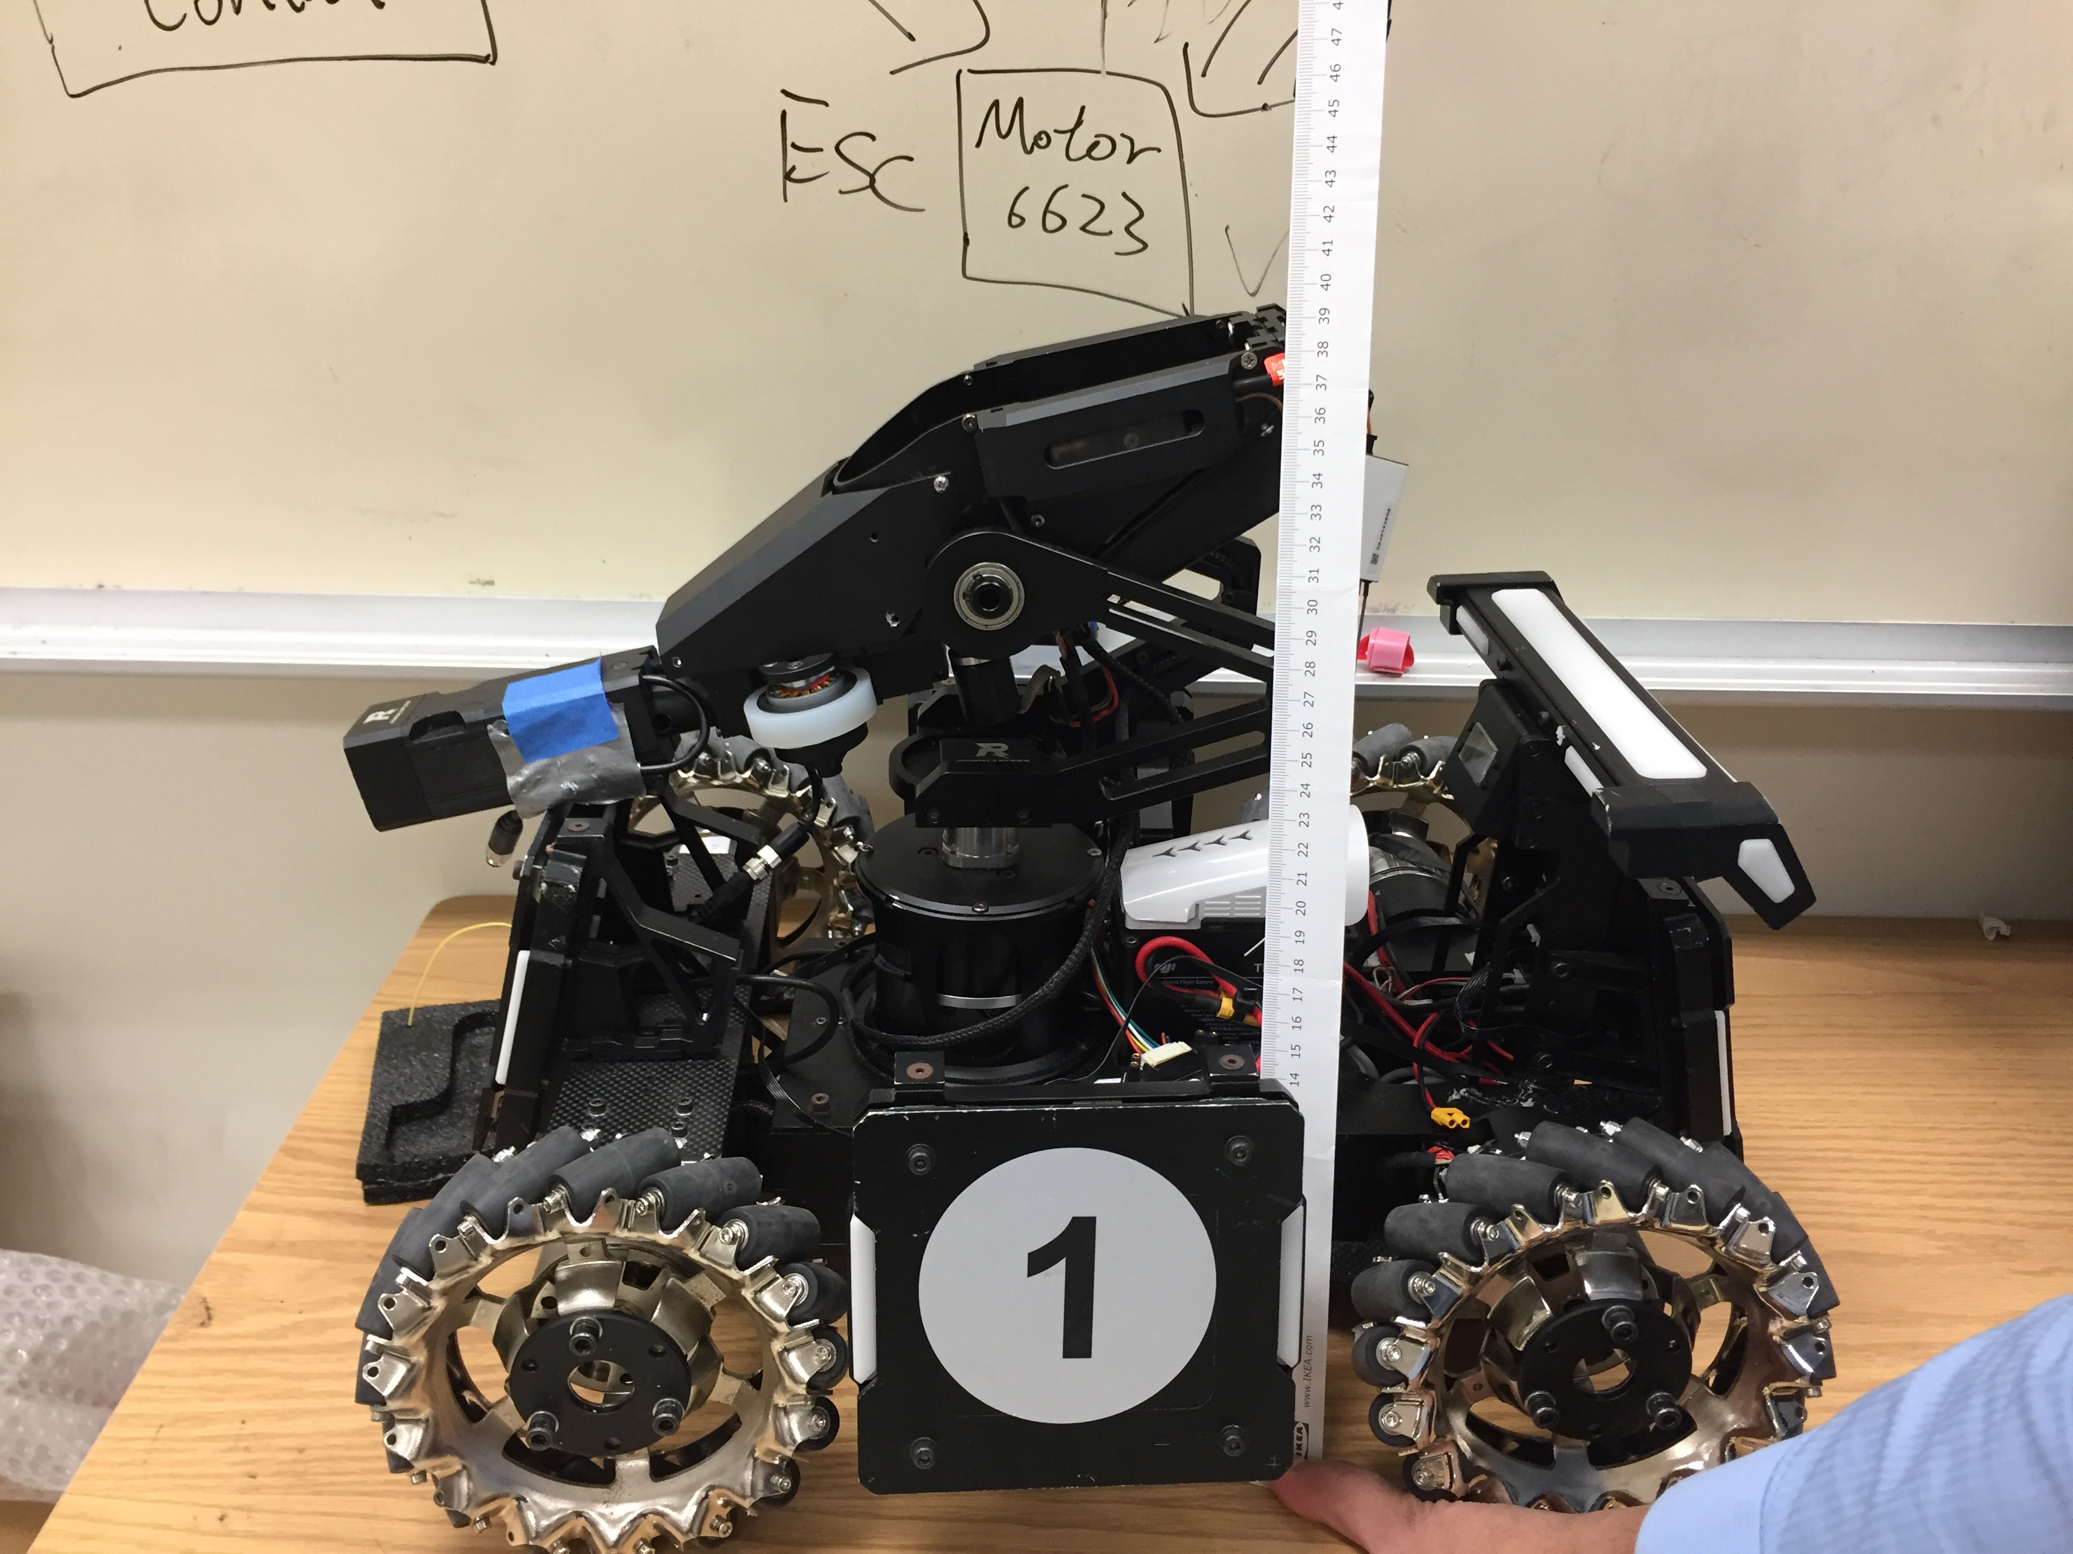
End User: Infantry Robot

Slide 15
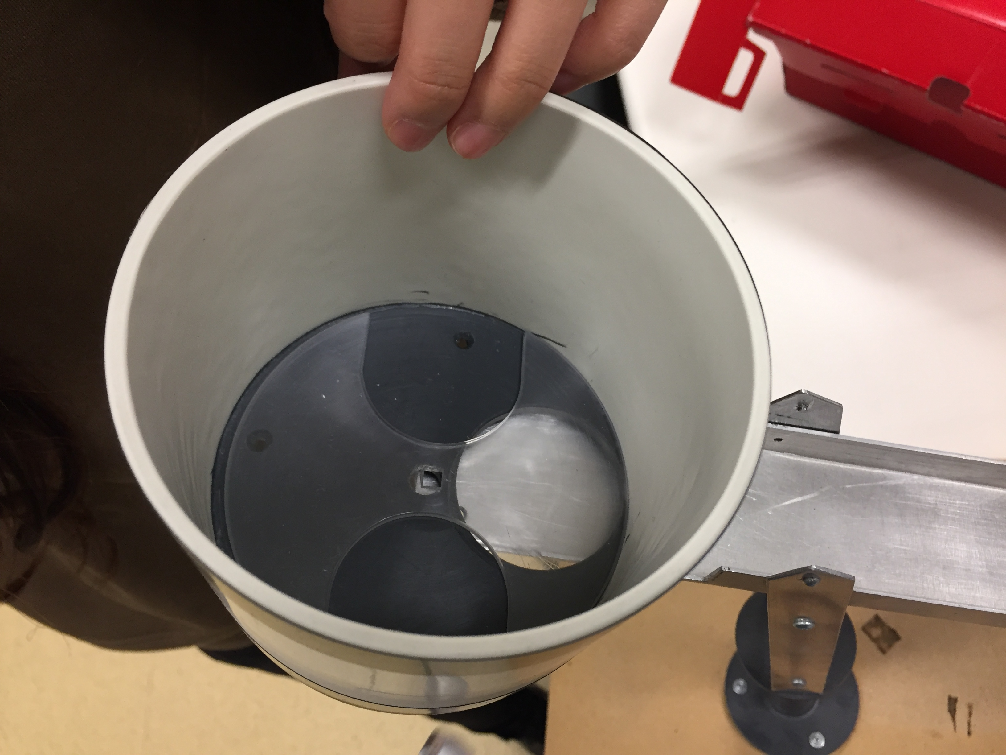
Bullet Holding Unit

Slide 16
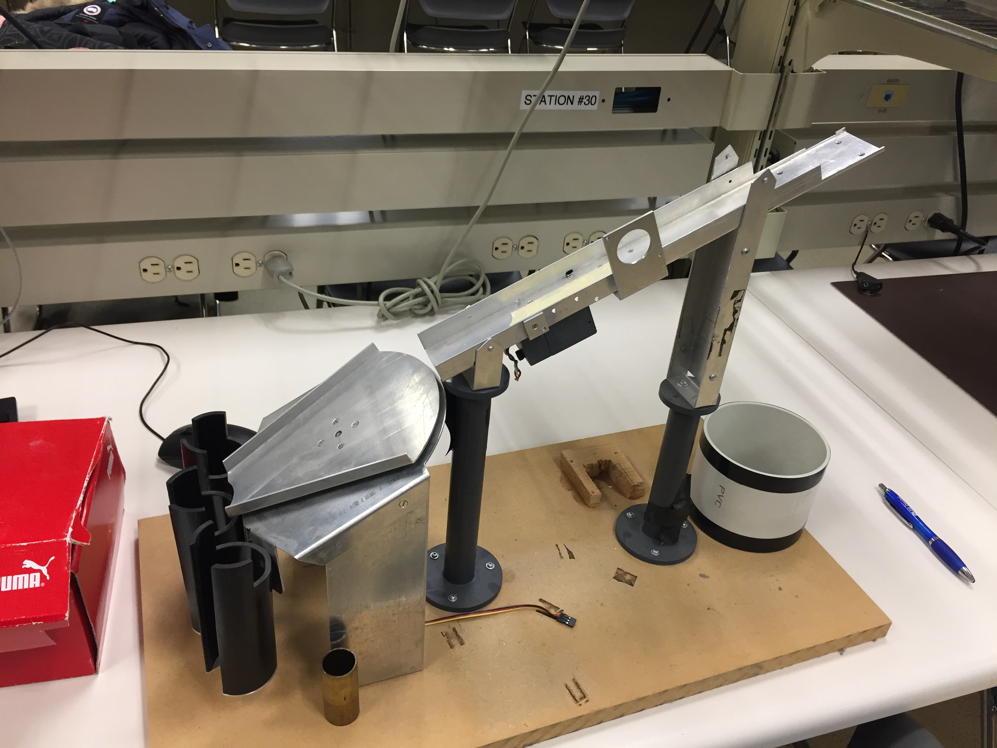
Infantry Robot

Slide 17
Milestones and Timeline of the Project
Month-Year | Oct - 17 | Nov - 17 | Dec - 17 | Jan – 18 | Feb - 18 | March - 18 | April – 18
Activities | Obtained the specification & Requirements Completed the specification sheet Completed the overall 1st mechanical design Consulted with the mechanical workshop | Did experiment of many mechanical designs regarding for the bullet distribution system Revised the mechanical design Finished the electrical schematic Completed some measurements | Complete all component selection and budget calculation Complete the CDR for the project | Conduct more experiments to test for the mechanical components and electrical components | Finish the electrical assembly and the prototype of the electrical components | Finish the assembly and all testing for the mechanical components | Finish the overall project on time and within budget

Slide 18
Components for supply station
12V motors: 12V 100RPM high torque DC Motor MCU: Arduino Uno Rev3 Motor Driver: Pololu Simple High-Power Motor Controller 18v15 Detect Sensor: QSD122A4R0-ND & QED123-ND Power source: NIMH Battery 12.0V 2300MAH

Slide 19
Budget
Components and Different Sources of Cost | Price in Canadian Currency
Arduino Uno Rev3 | $45.72
BATTERY PACK NIMH 12.0V 2300MAH | $55.00
Pololu Simple High-Power Motor Controller 18v15 | $106.24
2*12V 100RPM Brushed DC Motor | $49.95
4* QSD122A4R0-ND | $7.68
4*QED123-ND | $1.16
Estimate cost of all the materials and labors | $130
Total cost | $395.75

Slide 20
Suppliers
Components | Sources
Arduino Uno Rev3 | https://www.digikey.com/product-detail/en/arduino/A000066/1050-1024-ND/2784006
BATTERY PACK NIMH 12.0V 2300MAH | https://www.digikey.com/product-detail/en/energizer-battery-company/NH15VPF2X5/N703-F025-ND/1040731
Pololu Simple High-Power Motor Controller 18v15 | https://www.pololu.com/product/1376
12V 100RPM 583 oz-in Brushed DC Motor | http://www.robotshop.com/ca/en/12v-100rpm-583-oz-in-brushed-dc-motor.html
QSD-122-ND | https://www.digikey.com/product-detail/en/on-semiconductor/QSD122/QSD122-ND
QED123-ND | https://www.digikey.com/product-detail/en/on-semiconductor/QED123/QED123-ND/187398
Material Costs and Labour Cost | UAlberta Electrical Engineering Department
Steel and Aluminium Material | McMaster-Carr Company

Slide 21
Block Diagram
Infantry robot block infrared light
PWM signal (Low)
Arduino UNO R3(ATmega 328)
PWM signal (High = 5.0V)
Pololu High-Power Motor Driver 18V15
OUTA=high, OUTB=low, PWM=high
Pololu Motor rotate

Slide 22
Photo Interrupter
Transmission-type photo sensor
A light emitting elements
A light receiving elements
Acting as an optical switch
Infantry Robots Detector
Signal triggers after infantry robots block infrared light
Bullets will release from the second stage
Components:
QED123--- Plastic Infrared Light Emitting Diode
QSD122--- Plastic Silicon Infrared Phototransistor

Slide 23
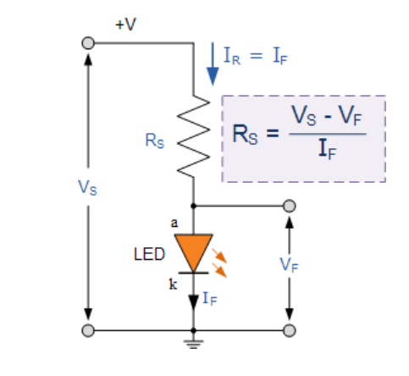
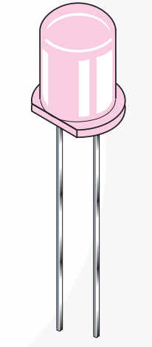
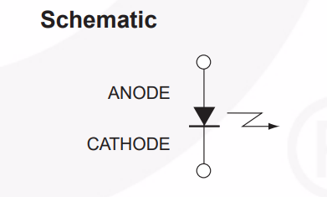
Photo Interrupter
QED123 : (Emitter)

Slide 24
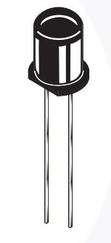
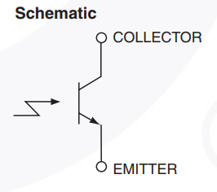
Photo Interrupter
QSD122: (Detector)
The base is left disconnected
Light is used to enable the current flow through the phototransistor.

Slide 25
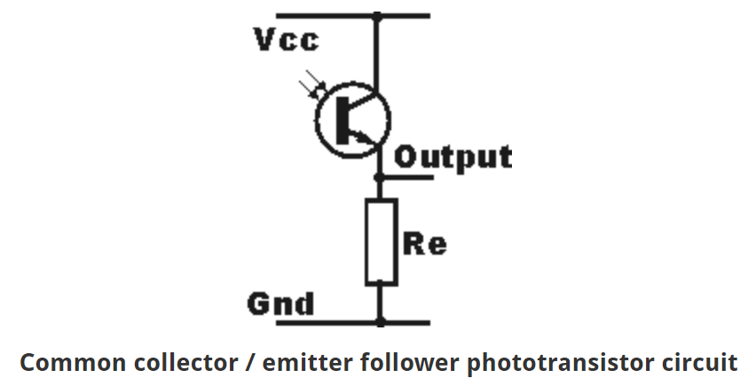
Photo Interrupter
Phototransistor Circuit:
2. Common Collector phototransistor circuit:
The output that moves from the low- state
to a high-state when light is detected.
Rc = Vcc-Vce / Ic

Slide 26
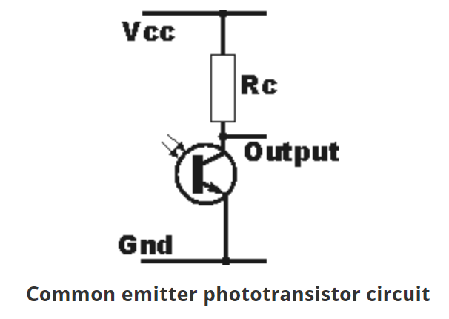
Photo Interrupter
Phototransistor Circuit:
1. Common Emitter phototransistor circuit:
The output moves from a high-voltage state to a low-voltage state when light is detected.
Rc = Vcc-Vce / Ic

Slide 27
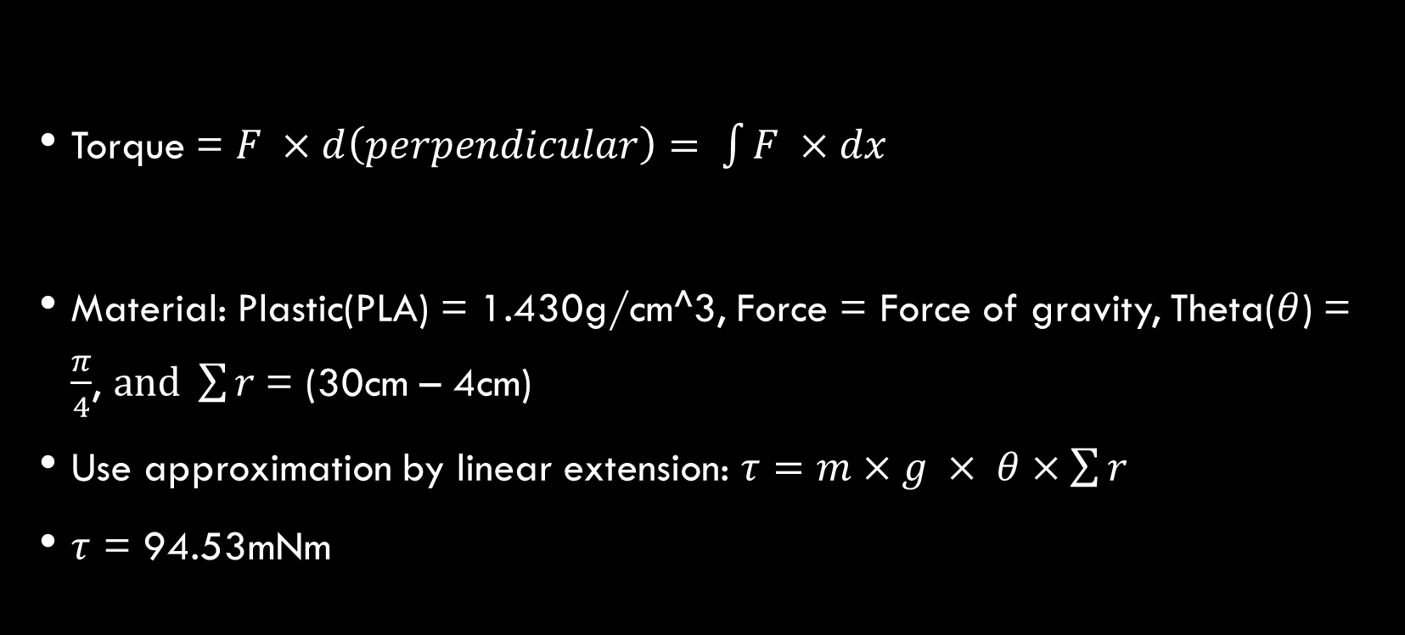
Calculations used in the design Regarding for the motor and the motor driver
Torque = $F ×d\left(perpendicular\right)= \int{F ×dx}$
Material: Plastic(PLA) = 1.430g/cm^3, Force = Force of gravity, Theta($θ$) = $\frac{π}{4}$, $and \sum{r}$= (30cm – 4cm)
Use approximation by linear extension: $τ=m×g × θ×\sum{r}$
$τ$ = 94.53mNm

Slide 28
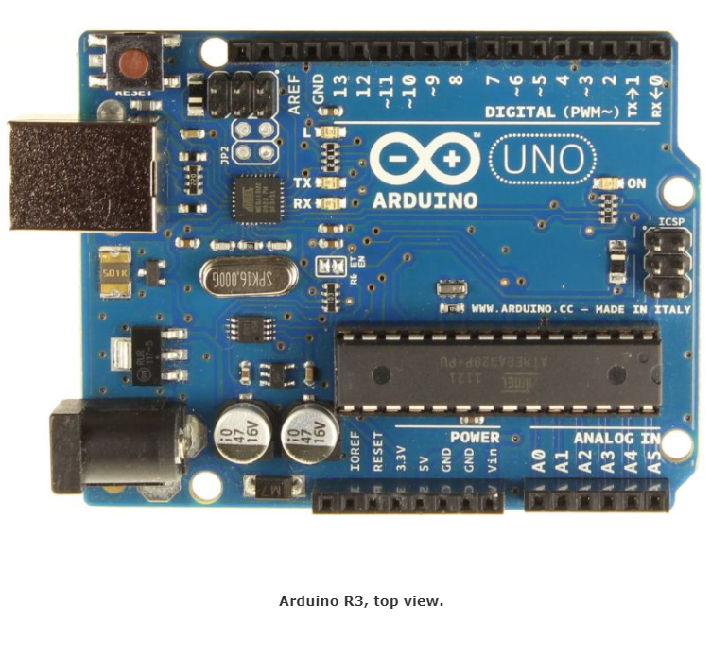
The Microcontroller Board Selected
Arduino Uno R3, using ATmega328P AVR microcontroller
20 digital input/output pins(6 can be used as PWM outputs and 6 can be used as analog inputs)
Extensive support community and easy to work with embedded electronics

Slide 29
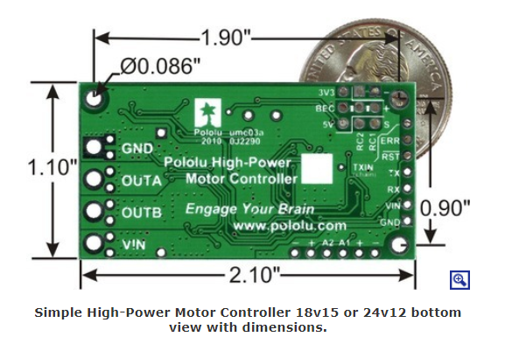
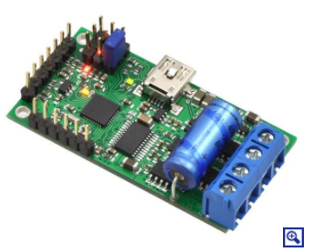
Motor Driver: Pololu simple high-power motor controller 18v15
Simple bidirectional control of one DC brush motor
5.5V to 30V operating supply voltage range
Enough to deliver a continuous 15A without a heat sink
Included axial capacitor that is installed directly on the board in the pins labelled ‘+’ and ‘-’ as shown

Slide 30
The Selected Motor (DC 12V)
DC 12V Motor Specification Sheet
Rated voltage: | 12 V
Gear reduction ratio: | 50:1
D output shaft diameter: | 6 mm
No-load speed: | 100 RPM @ 12 v
No-load current: | 0.17 A
Rated speed: | 93 RPM @ 12 v
Current rating: | 0.68 A
Rated torque: | 7 kg.cm
Stall torque: | 42 kg.cm (4.118793Nm)
Stall current: | 2.19 A
Power: | 5 w
Weight: | 210 g
Supply DC 12V
100 RPM Brushed DC Motor

Slide 31
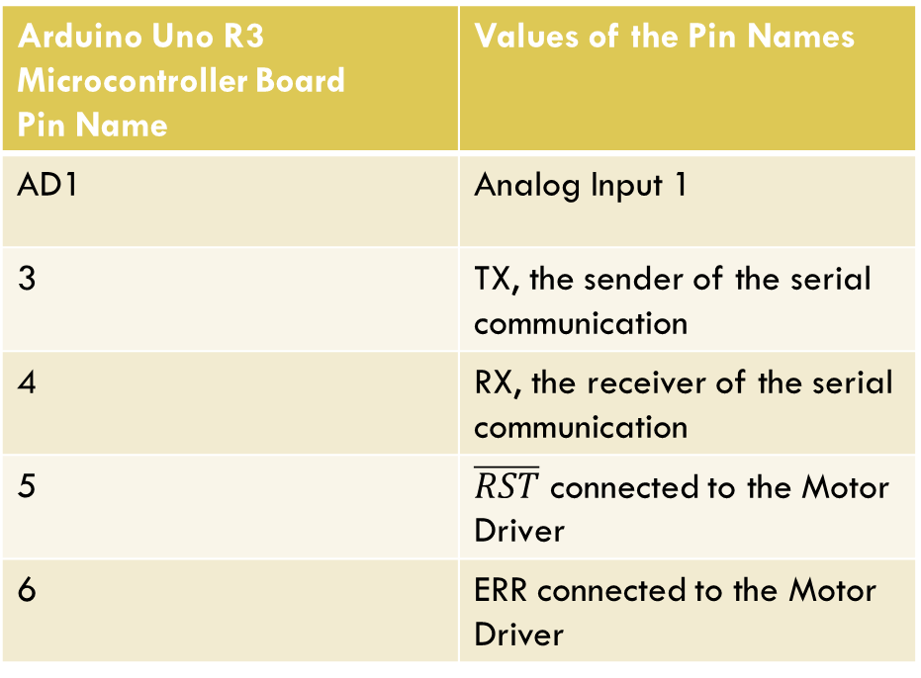
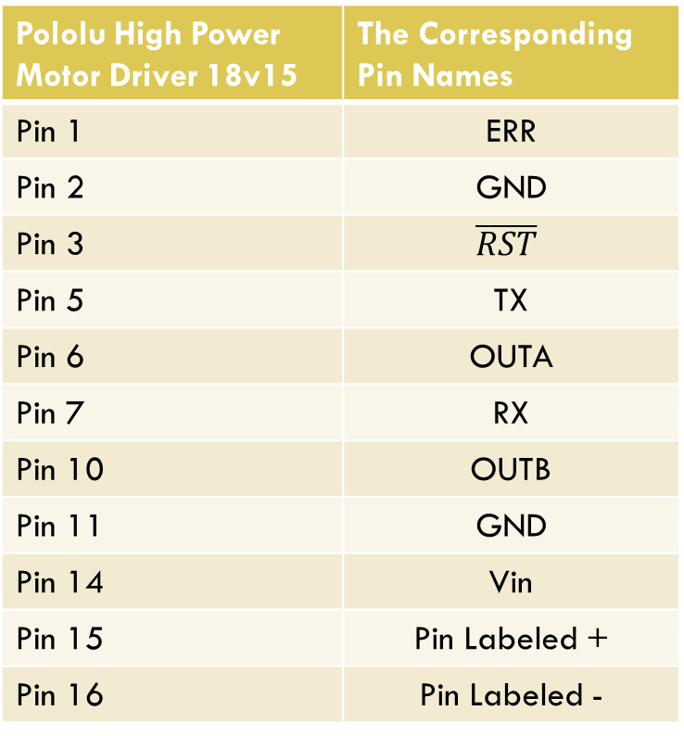
Tables of the Pins for the electrical components in the schematic design
Pololu High Power Motor Driver 18v15 | The Corresponding Pin Names
Pin 1 | ERR
Pin 2 | GND
Pin 3 | $$\overline{RST}$$
Pin 5 | TX
Pin 6 | OUTA
Pin 7 | RX
Pin 10 | OUTB
Pin 11 | GND
Pin 14 | Vin
Pin 15 | Pin Labeled +
Pin 16 | Pin Labeled -
Arduino Uno R3 Microcontroller Board Pin Name | Values of the Pin Names
AD1 | Analog Input 1
3 | TX, the sender of the serial communication
4 | RX, the receiver of the serial communication
5 | $\overline{RST}$ connected to the Motor Driver
6 | ERR connected to the Motor Driver

Slide 32
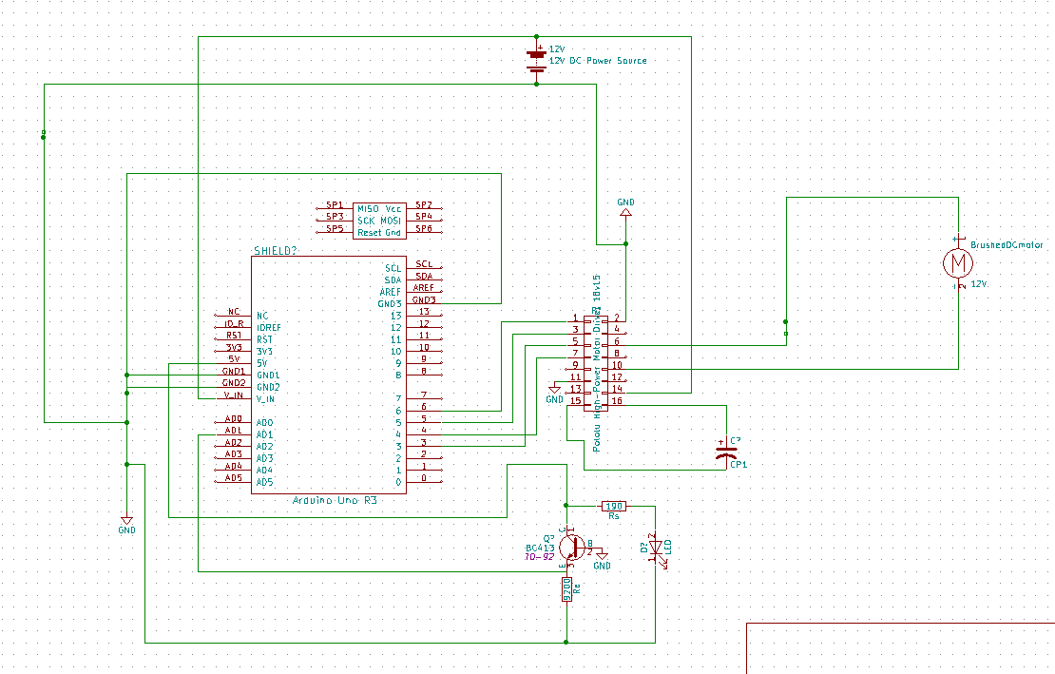
The electrical schematic of the detection system and the distribution system

Slide 33
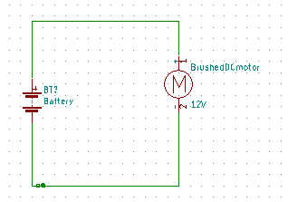
The Electrical schematic of the spinner
Modification, if needed:
Current Limiting Resistor can be added in series with the motor

Slide 34
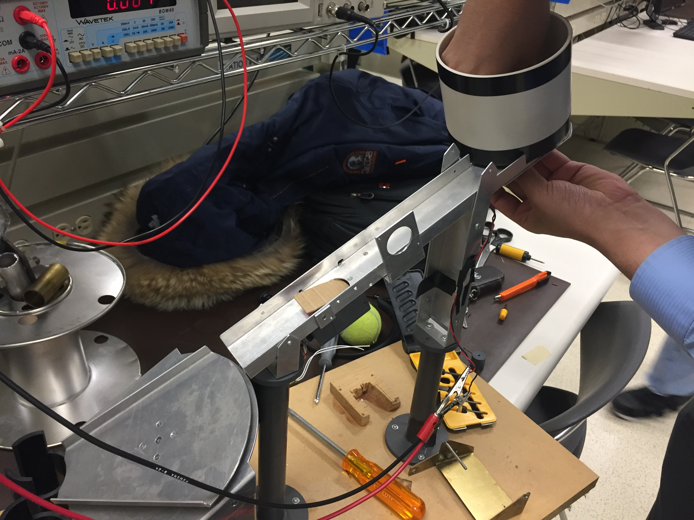
Infantry Robot

Slide 35
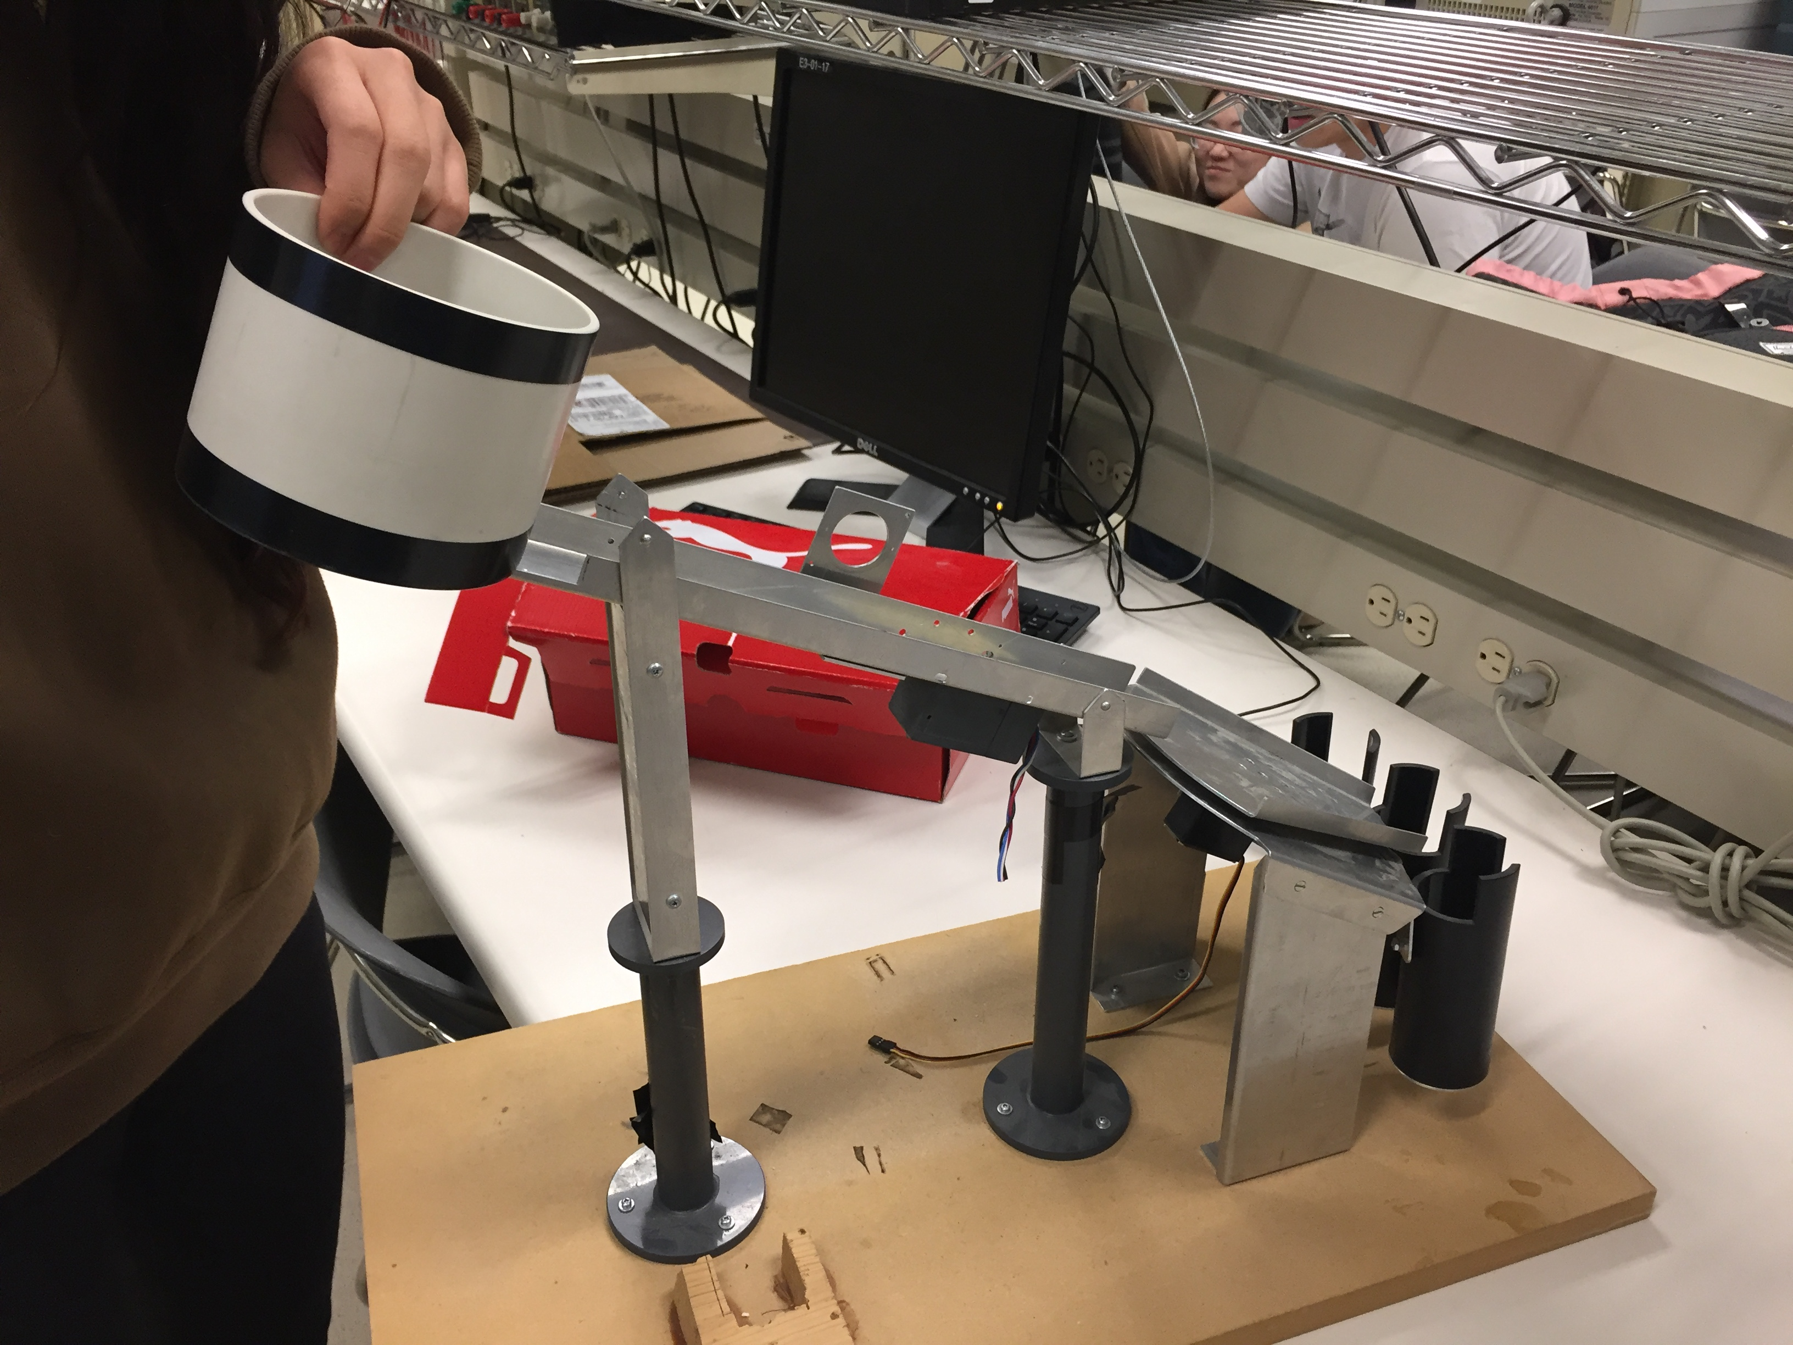
Infantry Robot

Slide 36
Questions & Feedbacks

Slide 37
References for the Microcontroller Board, Motor Driver, and the Motor Section
“Pololu Simple High-Power Motor Controller 18v15(Fully Assembled).” Internet: https://www.pololu.com/product/1376, Pololu, 2017
“Pololu - 1.2. 18v15 and 24v12 Included Hardware.” Internet: https://www.pololu.com/docs/0J44/1.2, Pololu, 2017
“Pololu - 6.7.1. Arduino Examples.” Internet: https://www.pololu.com/docs/0J44/6.7.1, Pololu, 2017
“Pololu Simple High-Power Motor Controller 18v15.” Internet: https://www.pololu.com/product/1377, Pololu, 2017
“Pololu - 4.2. Connecting a Serial Device.” Internet: https://www.pololu.com/docs/0J44/4.2, Pololu, 2017
“Pololu - Arduino Uno R3.” Internet: https://www.pololu.com/product/2191/specs, Pololu, 2017
“Arduino USB Board (Uno R3) : Solarbotics.” Internet: https://solarbotics.com/product/50450/?cid=1&gclid=EAIaIQobChMIprCeuJ_d1wIVxF9-Ch0q0gxAEAYYAiABEgL2r_D_BwE, Pololu, 2017
“Interfacing DC Motor with 8051 Microcontroller using L293D.” Internet: http://www.electronicshub.org/interfacing-dc-motor-8051-microcontroller/, Pololu, 2017
Authors: Russell C. Hibbeler, “Engineering Mechanics: Dynamics, 14th Edition”. Location: Toronto, Ca: Pearson, Mar 21, 2015
"Metal DC Geared Motor - 12V 100RPM 42kg.cm Datasheets", Media.digikey.com, 2008. [Online]. Available: https://media.digikey.com/pdf/Data%20Sheets/DFRobot%20PDFs/FIT0492-B_Web.pdf. [Accessed: 27- Nov- 2017].
"PRODUCT DATASHEET", Data.energizer.com, 2017. [Online]. Available: http://data.energizer.com/pdfs/nh15-2300.pdf. [Accessed: 27- Nov- 2017].
"Arduino Uno Rev3", Wecl.com.hk, 2017. [Online]. Available: https://www.arduino.cc/en/uploads/Main/Arduino_Uno_Rev3-schematic.pdf. [Accessed: 27- Nov- 2017].

Slide 38
Reference for the Photo Interruptor
Website title: Hades.mech.northwestern.edu
URL: http://hades.mech.northwestern.edu/images/f/fb/QED123.pdf
Website title: Mouser.com
URL: http://www.mouser.com/ds/2/149/QSD124-191888.pdf

